Slide 1
ERP SYSTEM FOR COLLEGE MANAGEMENT
Group-3

Slide 2
Team Members
Employee Id | Names
2496232 | Devashish Sinha(Front-End &Team Leader)
2495772 | N Smruti Ranjan Reddy(Back-End Leader)
2495296 | V Narayanan
2495545 | Pooja Wamanrao Pawar
2496045 | J.Haritha
2496213 | Kedam Rajesh
2496220 | Mohammad Abed Ali
2496226 | Vaibav Satish Atkare
2496060 | Bussareddy Anil
2495922 | Dudekula Kalam Basha

Slide 3
Project Objective
To create a dynamic and responsive java full stack web application for
ERP System for College Management.

Slide 4
Problem statement
In Existing System for managing various modules such as Student module, Administrative module and Exam cell etc. takes lot of paper work as well as time.
In Administrative module Timetable, and updation details, Profile views, Fees details, Results ,Events etc all are very difficult to manage using manual processes and it takes lot of time and paper work.

Slide 5
Solution
ERP stands for Enterprise Resource Planning.
Enterprise resource planning (ERP) is business management software or a system which is typically used to manage core departmental data of respective business.

Slide 6
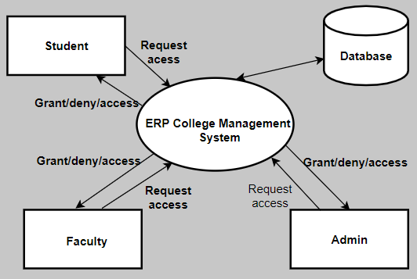
INTRODUCTION
ERP for College Management System:
ERP is tool used to collect college operations data and analyse.
Management uses this data to make informed decisions

Slide 7
Modules
Home Page
About Us
Student Login
Faculty Login
Admin Login
Librarian Login

Slide 8





Tools and Technologies
Front end: Angular
Server Side: Spring Boot
Back-end: Hibernate, MY SQL
Server: Tomcat 8.0

Slide 9
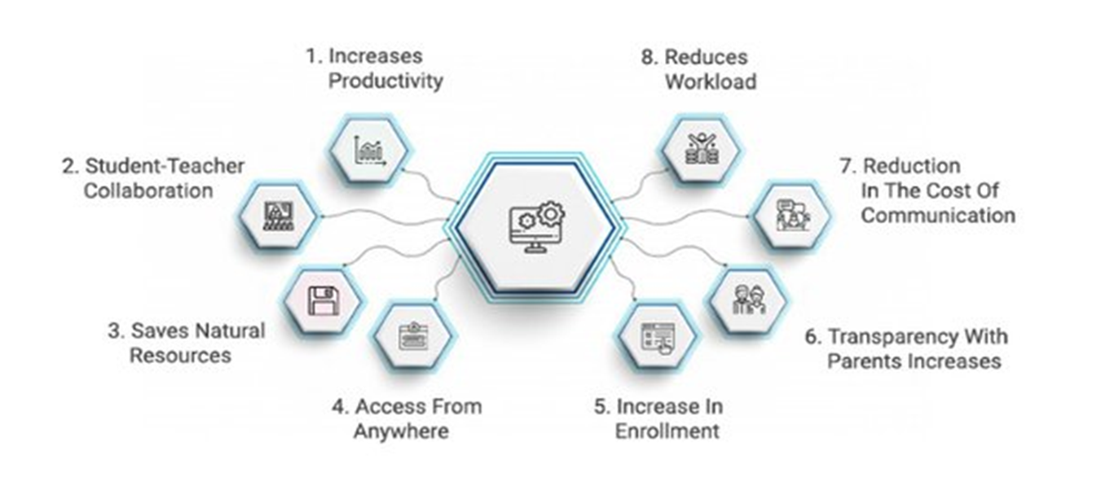
Advantages

Slide 10
Disadvantages
The installation of the ERP System is costly
Complex Data Conversion

Slide 11
Future Scope
Future Enhancements Make online exam more effective, efficient and more dynamic so that it helps to get a good support from the student. It has been marking while this application open in other browser due to designing support.

Slide 12
Conclusion
The “ERP” system has been developed by us and also done enhancement in application through applying our knowledge gained in class room, referring to certain books, browsing some sites and through the help of external and internal faculties and using our knowledge related to subject it. We are very thankful to all our team members that extended all their support and helped us complete this project successfully.

Slide 13


